Slide 1
I400 – Application Development in Java
Lecture 5

Slide 2
Today
CH 6 – Methods
Return types
Overloading
CH 7 – Arrays
Foreach loops

Slide 3
Methods – Java vs Python
In Python, only functions attached to objects were called methods.
In Java, all functions are referred to as methods.
Java requires us to spend more time explaining the data types used by our methods.

Slide 4
Methods Terminology
There are two major types of methods in Java:
void methods return no values. main() is generally a void method.
value-returning methods are the opposite.
The data the method accepts when it’s called are referred to as parameters.
When we pass actual values in during a call, we say that those are arguments.

Slide 5
Methods Syntax
The general structure for a method is as follows:
modifier returnValueType methodName (parameters) {
// code for method
}
The first line of the method is called the method header – it explains how the method can be used, what information it requires, and what it returns.

Slide 6
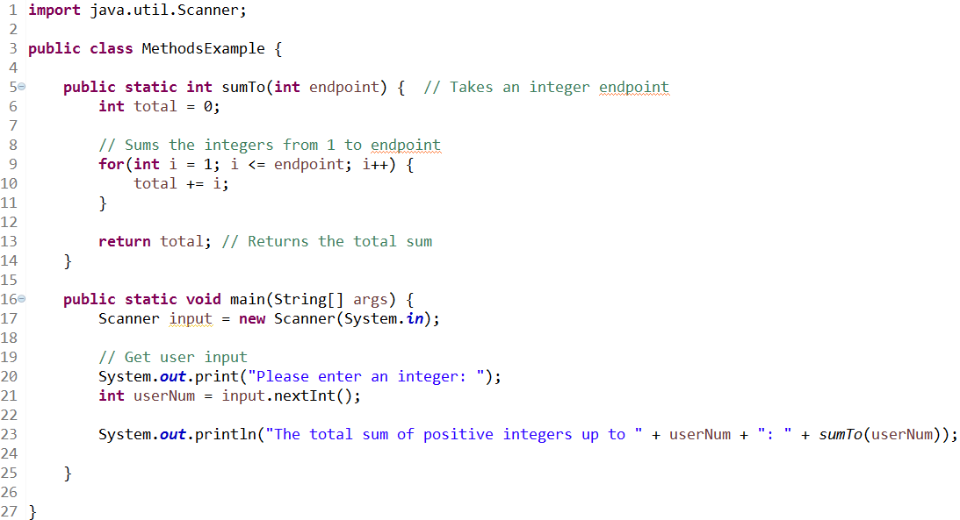
Method Example
Here we see two methods inside of the MethodsExample class.
Both are static methods – this has the same meaning in Java as it does in Python: we don’t require an instance of the class to use them.

Slide 7
Method Example
sumTo and main are both public methods, which has the same meaning in Java as in Python.

Slide 8
Method Example
sumTo, a value-returning method, has 1 argument, an integer named endpoint.
sumTo returns an integer as well.

Slide 9
Method Example
main, a void method, also accepts an argument. The way in which this is acquired is a little unusual, and we won’t worry about it for now.
Notice main doesn’t have a return statement!

Slide 10
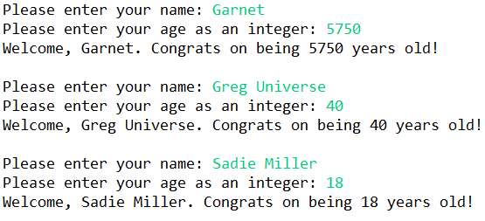
Greetings (Group Work)
In a class with your choice of name, write the greeting method:
public static void greeting(String name, int age)
Your program should call the method inside a loop (in main, which is also where you get user input) to output information on three people:

Slide 11
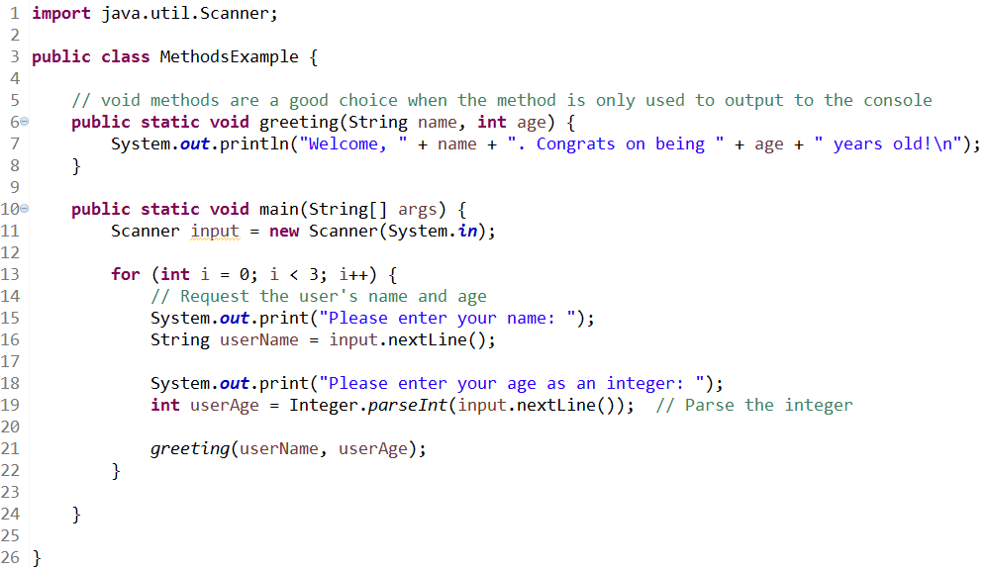
Greetings (Solution)

Slide 12
Overloading Methods
Like in Python, we can overload methods in Java. (Have multiple methods with the same name)
Overloaded methods must differ by either:
Taking parameters of different data types
or
Taking different numbers of parameters

Slide 13
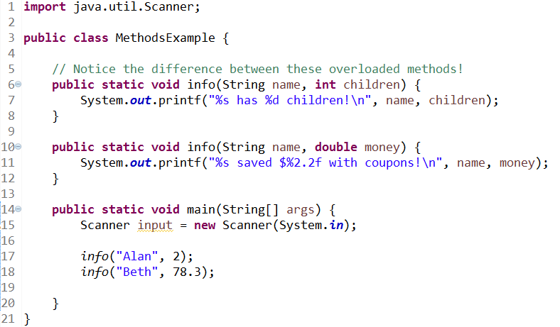

Overloading Example
Java will invoke the best match for overloads:

Slide 14
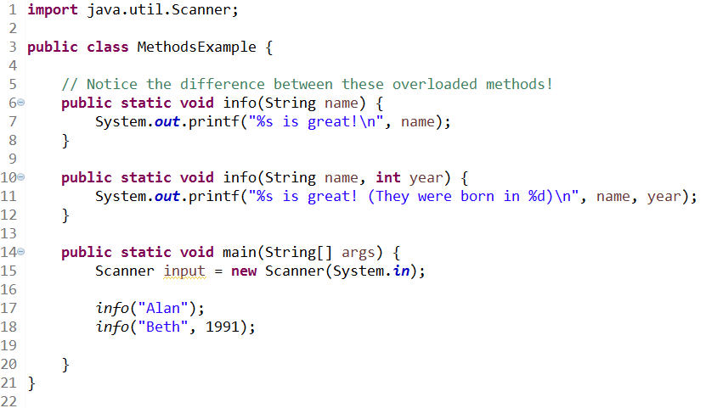

Overloading Example
Java will invoke the best match for overloads:

Slide 15
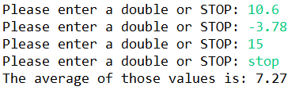
Double Average (Group Work)
In a class with your choice of name, write the doubleAverage method, which is value-returning:
public static double doubleAverage(Scanner input)
The doubleAverage method allows the user to input doubles until they choose stop, then returns the average. Your program should call the method in main.
NOTE: This problem doesn’t use Overloading, even though we just talked about that.

Slide 16
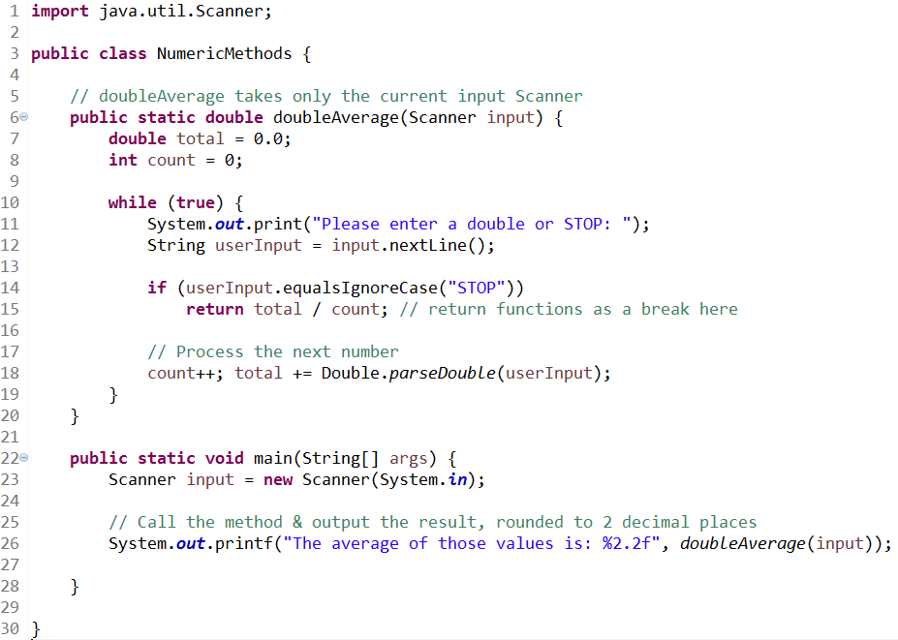
Double Average (Solution)

Slide 17
Arrays – Java vs Python
Java uses arrays as its base sequence for non-character objects. Think of them as similar to tuples from Python.
Arrays have to be declared of a specific size and data type – they cannot grow or shrink, and they cannot store data of multiple types.

Slide 18
Array Declaration
Arrays in Java are declared like this:
double[] numList = new double[10];
This creates an array of doubles with 10 spaces in it.
If you only need a few elements in an array, you can use array initializer notation:
double[] numList = {1.2, 3.4, -2.7, 6.0};

Slide 19
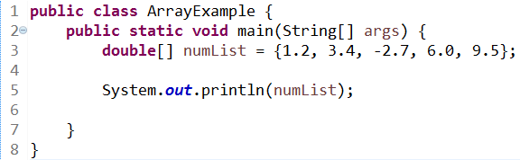

Outputting an Array
Since arrays are objects containing multiple values, printing the entire array out is not helpful:
This is a memory reference!

Slide 20
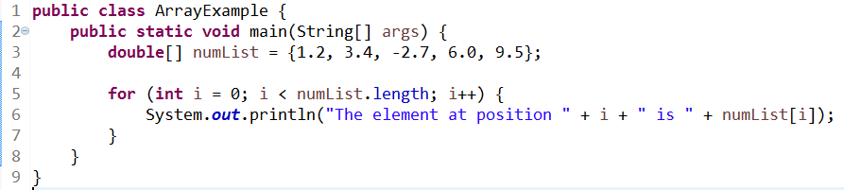
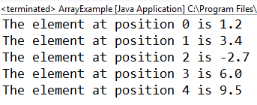
Outputting an Array
Indexing with the loop control variable of a for loop is still very effective:

Slide 21
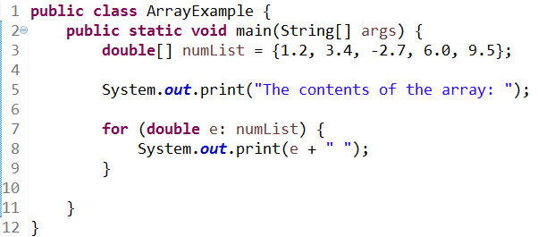
Foreach Loop
If you don’t care about the index numbers, you can use a foreach loop:
This is the same as the for elem in sequence loop in Python.

Slide 22
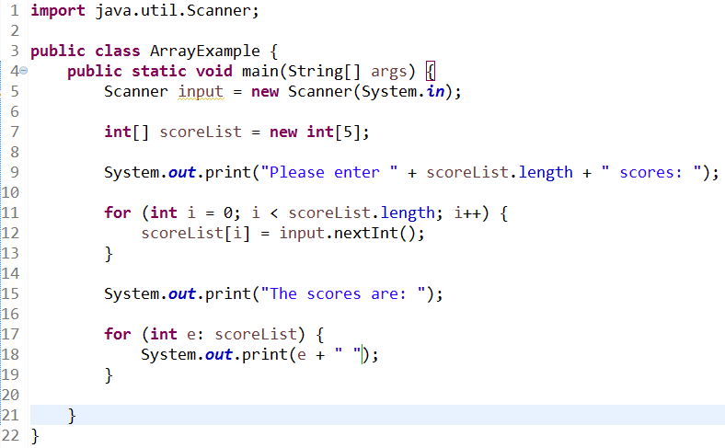

Filling Arrays with Input
To directly fill an array with user input:

Slide 23
Pass By Reference Vs Value
We might want to pass an array to a function. Remember this difference from I210?

Slide 24
Pass By Reference Vs Value
Java is technically pass-by-value, always.
However, the value of an array IS a memory reference, so when we pass that, it functions like pass-by-reference.
The main lesson is to be careful what is done to arrays passed to methods!

Slide 25
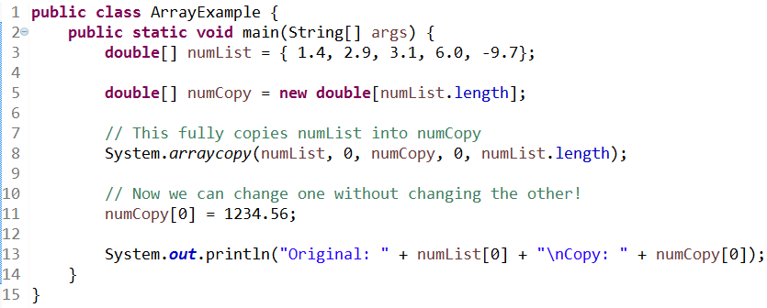

Copying an Array
The System class gives us a method for copying arrays:

Slide 26
Questions?

